Slide 1
Public Health - Clinical LOINC Meeting
Sundak Ganesan, M.D.
Health Scientist, Surveillance Operations Team
National Notifiable Disease Surveillance (NNDSS) Team
Centers for Disease Control and Prevention (CDC)
August 26th 2016
Center for Surveillance, Epidemiology, and Laboratory Services
Division of Health Informatics and Surveillance

Slide 2
Agenda
Public Health Informatics Update
Zika update
Case Notification LOINC Request & Process
LOINC Submission Clarification
Zika – Mosquito Count, Species
Measles
Babesiosis
Public Health Data Element Repository Requirements

Slide 3
Public Health Informatics Update
Public Health Informatics Conference (August 21st to 24th)
Clinical Decision Support (?? Role of CDC/Public Health)
Case Notification (State Health Dept to CDC)
eCR – Electronic Initial Case Reporting (CDA)
EMR (healthcare providers to State Health Dept)
Stage 3 Meaningful Use (to be ready by July 1st 2017)
EHR vocabulary trigger codes for initial case report
Diagnosis (ICD-10, SNOMED CT)
Lab (LOINC/SNOMED)
Data Element Harmonization
120 Surveillance Systems within CDC
Need for Data Element Repository
Options – RELMA, PHIN VADS, NLM CDE, NCI CDE browser, AHRQ
Metadata Repository
Linking data elements to other metadata like messaging guide, usage by programs, version control, etc..

Slide 4
Case Notification LOINC Request Process
Review internally within CDC by Vocabulary Review Board
Provide additional materials such as Case Report form, HL7 message or sample segments, if needed.
Timeline – 45 to 60 days would be ideal and would like to submit the request when the messaging guides are going for external review (45 days)
Expedited Processing for non-emergency situations
Funding Options
Premier Membership, etc…

Slide 5
Zika Update
Pregnancy Status – ELR, EMR
Zika affected areas
CDS – Clinical Decision Support
Role of CDC (Where do we stop?
Clear Guidelines
?? Virtual Medical Record
Not overprescribe and tell CDS community about how to do CDS and specific formalism
InfoButton – University of Utah
ONC – EHR Vendors collaboration

Slide 6
Public Health Case Notification - Interaction between HL7 message Structure and Terminology (LOINC/ SNOMED)
Overview of HL7 2.5.1 Case Notification Structure
OBR (only one) = Epidemiologist’s section that represents data elements from Case Report Form / Public Health Surveillance System and contains public health investigation data.
Primarily uses OBX-3, OBX-4, OBX-5 , OBX-6 and OBX-11
OBR (1 or more) = Associated Lab Report (like ELR) to hold lab report that comes through ELR.
Uses all OBX fields like ELR specification (HL7 2.5.1)
OBR, OBX, NTE and SPM segments
Supports parent-child / reflex tests (Culture, Susceptibility)
Data Element Modules (Grouping)
Generic (Common data elements) for all conditions
Condition specific data elements (Hepatitis, STD, Arboviral, Measles, Mumps)
Note: All these data elements would be in OBR=Epidemiologist section and need a unique LOINC code for data elements
Example: “Reporting Source for Case” and “Vaccination Information Source” need to have unique ID’s and can’t map to same “Information Source” LOINC code.

Slide 7
LOINC Submission Clarification
Zika – Mosquito Count, Species
Measles
Babesiosis

Slide 8
Case Notification - National Notifiable Disease Surveillance System (NNDSS)
NNDSS Modernization Initiative – Link
Http://www.cdc.gov/nmi/index.html
CDC Draft NNDSS Message Mapping Guides
http://wwwn.cdc.gov/nndss/message-mapping-guides.html
Notifiable Conditions Reporting Mechanisms
http://wwwn.cdc.gov/nndss/document/Notifiable_Events_and_Notification_Mechanisms_for_2015_v3.xlsx
List of Notifiable Conditions
http://wwwn.cdc.gov/nndss/conditions/

Slide 9
Case Notification Messaging Artifacts
HL7 Case Notification Message Specification - link
Data Elements – Message Mapping Guide (MMG) - link
Generic V2 MMG
+
Condition Specific Message Mapping Guide

Slide 10
Layout of Data Elements in Case Notification Message Mapping Guides
Generic Case Notification Data Elements (core data elements for all notifiable conditions)
Condition Specific Data Elements as it appears in Case Report Form or Surveillance Worksheet (Interpretative/Investigation / Risk Factors, etc..)
Lab Template – Data elements representing Lab Report (Electronic Lab Report or Manual/Fax Report)

Slide 11
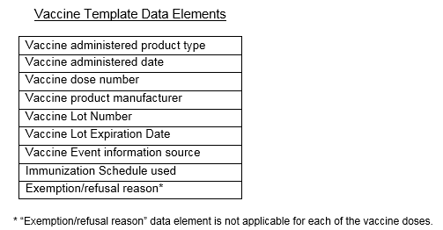
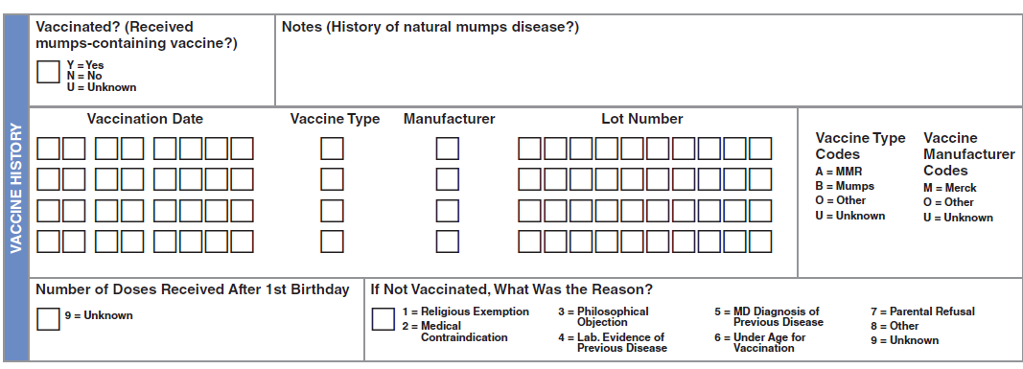
Vaccine Template

Slide 12
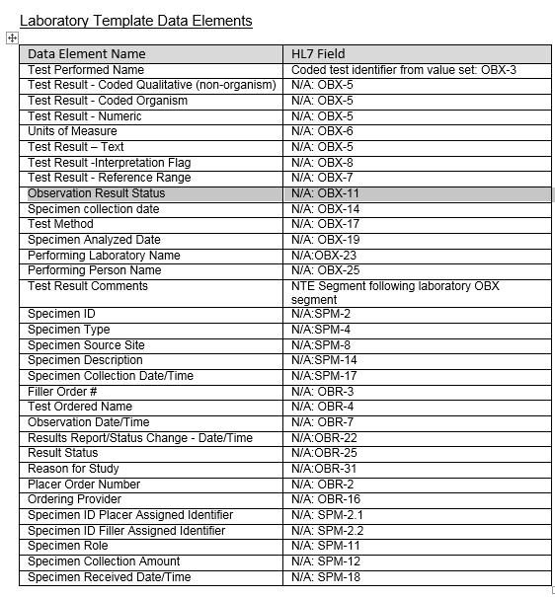
Lab Template

Slide 14
For more information please contact Centers for Disease Control and Prevention
1600 Clifton Road NE, Atlanta, GA 30333
Telephone: 1-800-CDC-INFO (232-4636)/TTY: 1-888-232-6348
Visit: http://www.cdc.gov | Contact CDC at: 1-800-CDC-INFO or http://www.cdc.gov/info
The findings and conclusions in this report are those of the authors and do not necessarily represent the official position of the Centers for Disease Control and Prevention.
Center for Surveillance, Epidemiology, and Laboratory Services
Division of Health Informatics and Surveillance

